Slide 1
Revision of Classifications
International Standard Industrial Classification of All Economic Activities (ISIC)
and
Central Product Classification (CPC)
Zhiyuan Qian, United Nations Statistics Division
International Workshop on the Integrated Use of International Trade Statistics and Economic Statistics
Beijing, China, 23 - 25 November 2021

Slide 2
Outline of presentation
United Nations Committee of Experts on International Statistical Classifications (UNCEISC)
International Family of Classifications
International Standard Industrial Classification of All Economic Activities (ISIC) 所有经济活动的国际标准行业分类
Central Product Classification (CPC) 产品总分类

Slide 3
United Nations Committee of Experts on International Statistical Classifications (UNCEISC)
UNCEISC is the central coordination body for
Work on international statistical classifications that are the responsibility of the Statistics Division, e.g., ISIC, CPC.
Coordination and review of other international statistical classifications that are the responsibility of other international organizations and that have been proposed for adoption by the Statistical Commission, e.g., International Classification of Non-Tariff Measures by UNCTAD.
Before 2021, UNCEISC was known as the Expert Group on International Statistical Classifications
Notes:
UNCTAD, International Classification of Non-Tariff Measures, approved by the Statistical Commission in March 2019. Available at https://unstats.un.org/unsd/statcom/50th-session/documents/BG-Item3h-NTM%20classification-E.pdf

Slide 4
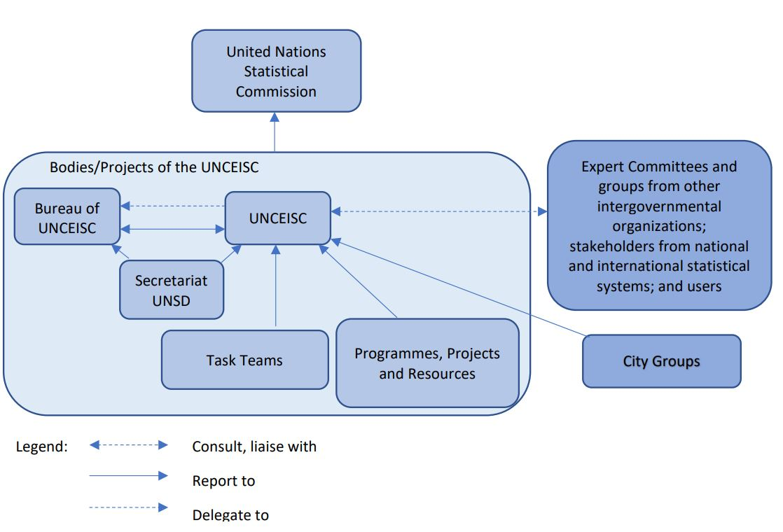
UNCEISC — Governance Structure
Notes:
Members of the UNCEUSC will comprise high-level representatives from national Governments and international and regional organizations with expertise in international statistical classifications. In addition, members will be selected so as to ensure equitable regional country and agency representation.
The UNCEISC has in its governance structure:
Chair: elected for a period of three years, and renewable for one term. The Chair represents the Committee at international meetings.
Bureau: day-to-day management of the programme of work and the projects of the UNCEISC.
Secretariat: the main source of logistical and administrative support for the UNCEISC. Currently UNSD serves as Secretariat.
Task Teams: created by the UNCEISC to address specific topics with a limited lifetime (generally, 2 years). There are currently a Task Team on ISIC and another on CPC.

Slide 5
International Family of Classifications
Is comprised of those classifications that
play a role as standard classifications in individual or multiple statistical domains, and
have been reviewed and approved as guidelines by the Statistical Commission or another competent intergovernmental body
The classifications cover domains such as economics, demographics, labour, health, education, social welfare, geography, environment and tourism.
The International Family of Classifications is maintained on UNSD website at https://unstats.un.org/unsd/classifications/Family

Slide 6
International Standard Industrial Classification of All Economic Activities (ISIC)
Is the international reference classification of productive activities. Its main purpose is to provide a set of activity categories that can be utilized for the collection and reporting of statistics according to such activities.
Some countries utilized ISIC as the basis for developing their national industrial
classifications. For example, GB/T 4754—2017《国民经济行业分类》
ISIC, Rev. 4 was published in 2008.
In March 2021, the UN Statistical Commission endorsed the revision process of ISIC, Rev. 4.
Notes:
GB/T 4754—2017《 国民经济行业分类》, ICNEA, http://www.stats.gov.cn/tjsj/tjbz/hyflbz/201905/P020190716349644060705.pdf

Slide 7
Major issues in ISIC, Rev. 4
Difficulty in maintaining the store and non-store retail distinction.
Intermediary services are not identified.
...
Roadmap for a new revision of ISIC
The Task Team on ISIC (TT-ISIC) has been meeting regularly for the past two years to resolve the issues that were collected during the global consultation, and is working now to develop a new ISIC structure. Work progress will be reported to the Statistical Commission at its 53rd session in March 2022.
The revision of ISIC is always an opportunity to further align national and regional classifications with ISIC.
Notes:
Description of ISIC Issues:
Store and non-store retail distinction. ISIC, Rev. 4 currently maintains a distinction between a classical store and an online store, but this distinction is facing increasing difficulties as a growing number of retail activities are carried out both in-store and online.
Intermediary services. With the help of modern technology, an ever-increasing number of businesses are acting as intermediaries between buyers and sellers, offering services such as delivery of restaurant prepared food, making reservations for transportation, hotels, and special events. Those businesses do not provide the products that the buyers really want, but only facilitates the transaction between the buyers and the sellers.
A consolidated list of issues is available at:
https://unstats.un.org/unsd/statcom/52nd-session/documents/BG-3k-TSG-ISIC-report-to-EGISC-E.pdf

Slide 8
Timeline for the revision of ISIC
A global consultation was conducted in 2019 to collect issues in ISIC. 109 countries and 6 international organizations sent responses.
A new structure of ISIC three-digit level will be submitted to the UNSC in March 2022.
A new ISIC structure with all four levels and explanatory notes will be finalized in 2022.
A global consultation on the new ISIC will be conducted by the end of 2022.
A finalized ISIC will be submitted to the UNSC for approval in 2023.

Slide 9
Central Product Classification (CPC)
Serves as an international standard for assembling and tabulating all kinds of data requiring product details
Used in statistical areas such as industrial production, domestic and foreign commodity trade, international trade in services, balance of payments, consumption and price statistics and other data used within the national accounts.
It is the basis for 中国国家统计局令第13号《统计用产品分类目录》2010.
Current version is CPC, Ver. 2.1, published in 2015.
In March 2021, the UN Statistical Commission endorsed the revision of CPC.
Notes:
中国国家统计局令第13号《统计用产品分类目录》2010, http://www.stats.gov.cn/tjsj/tjbz/tjypflml/

Slide 10
Roadmap for the revision of CPC
The TT-CPC has been meeting regularly since August 2021.
A list of issues in CPC is being prepared, including:
New products (goods and services) such as social media, digital products, forestry, pesticides and fertilizers, etc.
Alignment of CPC with ISIC, HS, and other classifications.
Protection of environment, treatment of waste, etc.
…

Slide 11
Timeline for the revision of CPC
November 2021 – conduct a global consultation to collect issues with the classification and review results of that consultation.
December 2021 – Develop a complete draft structure of the revised CPC.
January 2022 – Revise and finalize explanatory notes and correspondences, circulate the finalized classification for global consultation and submit for approval process of the revised Central Product Classification.
Mar 2023 – adoption of the revised CPC by the UNSC.

Slide 12
Available resources for ISIC and CPC
Classifications in the UNSD Publications Catalogue at:
https://unstats.un.org/unsd/classifications/unsdclassifications
Structures and correspondence tables as downloadable resources:
https://unstats.un.org/unsd/classifications/Econ
Where you can find classifications related to economic statistics, in all historical and current versions, and in multiple formats and languages
Structures of ISIC and CPC in interactive web form:
https://unstats.un.org/unsd/classifications/Econ/Structure

Slide 13
Available resources on classifications
Latest reports to the Statistical Commission are available at
https://unstats.un.org/unsd/statcom/52nd-session/documents/
Where you can find the Mandate and Governance of UNCEISC, and the TORs of TT-ISIC and TT-CPC.
Outputs and work progress reports of TT-ISIC and TT-CPC will be released in due course.
Inquiries can be sent to UNSD classifications hotline chl@un.org

Slide 14
Thank you!
谢谢！

